Slide 1
Final Engagement
Attack, Defense & Analysis of a Vulnerable Network
Oliver Boughey, Nicola Drummy, Jake Korljan & Craig Spencer

Slide 2
Table of Contents
This presentation contains the following content
Network Topology & Critical Vulnerabilities
Exploits Used
Methods Used to Avoiding Detection

Slide 3

Network Topology
& Critical Vulnerabilities
‹#›

Slide 4
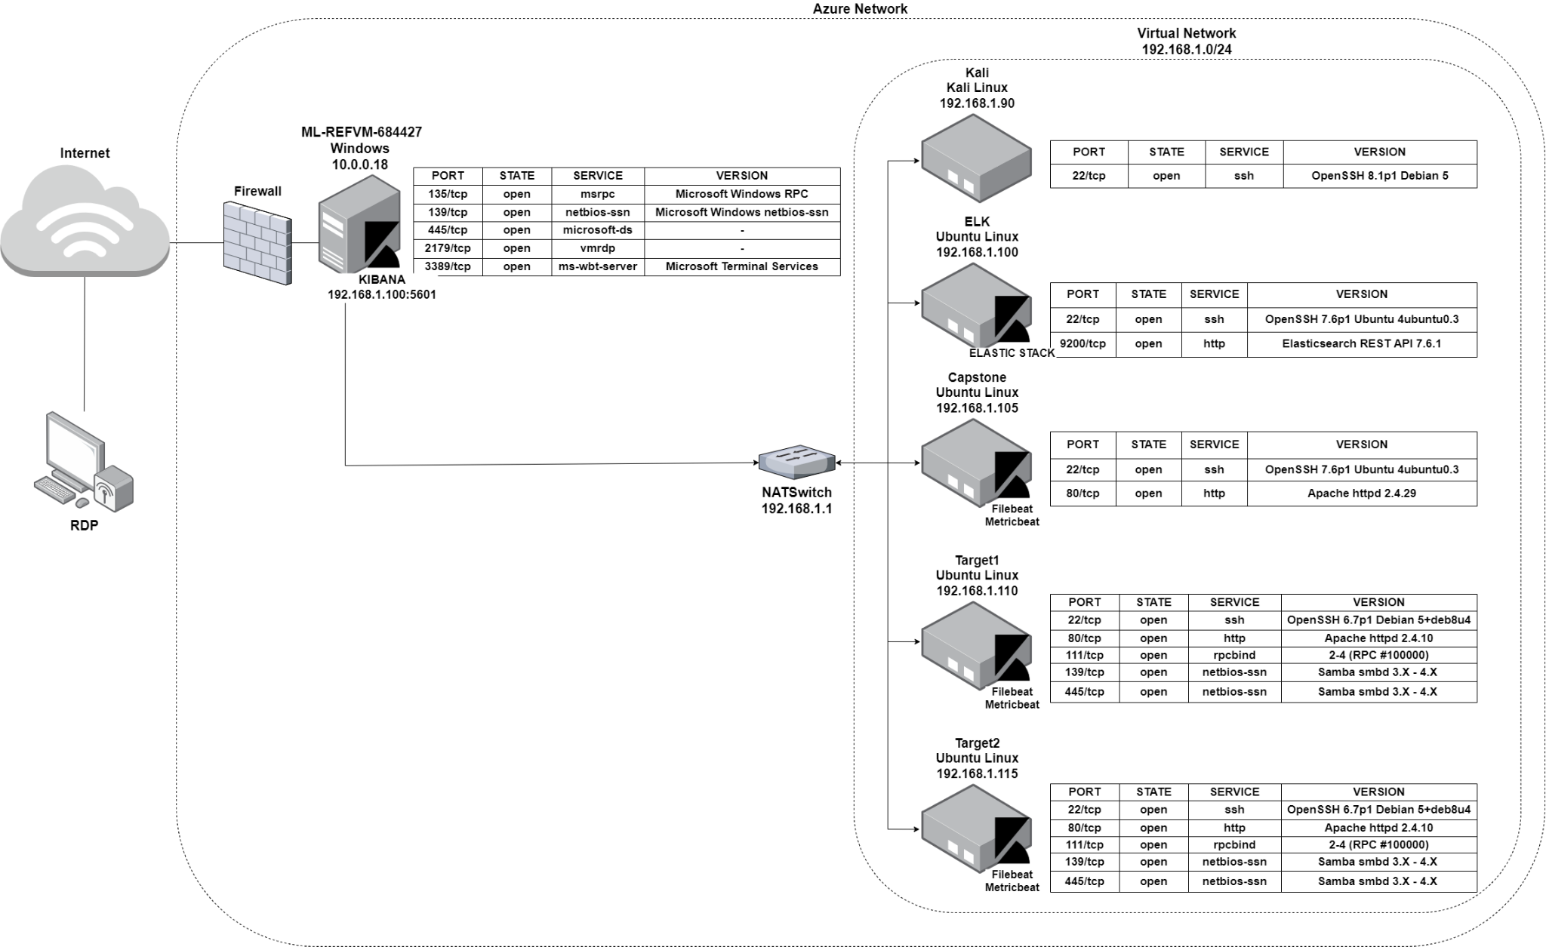
Network Topology
Network
Address Range: 192.168.1.0/24
Netmask: 255.255.255.0
Gateway: 192.168.1.1
Machines
IPv4: 192.168.1.90
OS: Linux 5.4.0
Hostname: Kali
IPv4: 192.168.1.100
OS: Ubuntu 18.04.1 LTS
Hostname: ELK
IPv4:192.168.1.105
OS: Ubuntu 18.04.1 LTS
Hostname: Capstone
IPv4: 192.168.1.110
OS: Linux 3.2 4.9
Hostname: Target 1
IPv4: 192.168.1.115
OS: Linux 3.2 4.9
Hostname: Target 2

Slide 5
Critical Vulnerabilities: Target 1
Our assessment uncovered the following critical vulnerabilities in Target 1.
Vulnerability | Description | Impact
Responded to Nmap Network Scan | Target1 respond to the Nmap scan, enabling enumeration of the open ports and software versions. | Discovered port 22 and 80 open, providing access points to server for further information gathering.
Responded to WordPress Scan | The wpscan enumerated two user names. | This information provided the first half of gaining user access to “Target1” via the open SSH port.
Weak user passwords | User Michael’s password was “michael”, which was easily guessed. | Guessing the password allowed access to “Target1” via SSH.
MySql password discoverable in plain text | MySql database configuration revealed the password to gain access. | Used these credentials to log in to MySql and search tables for information, revealing user Steven’s hashed password.
Unsalted user password hashes | Two password hashes were identified in the MySql database. | Steven’s password was included in the “rockyou.txt” wordlist and therefore crackable using the Kali tool, “John”.
Python root user privilege escalation | One user had unrestricted permission with no password in the sudoers list to execute Python. | Used a python vulnerability to gain root access, Allowing for the establishment of an advanced persistent threat.

Slide 6
Exploits Used
‹#›

Slide 7
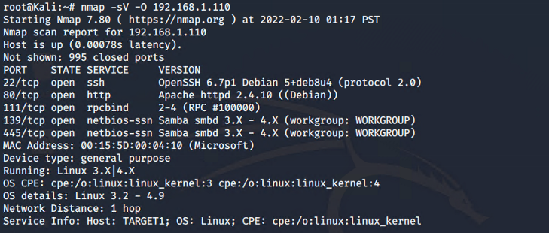
Exploitation: Network Mapping and User Enumeration (WordPress site)
Nmap was used to enumerate open ports, running services, and OS details, including the detection of other machines on the network.
Open Port 80 (HTTP) and Port 22 (SSH) provided access to the server.
# nmap -sV -O 192.168.1.110

Slide 8
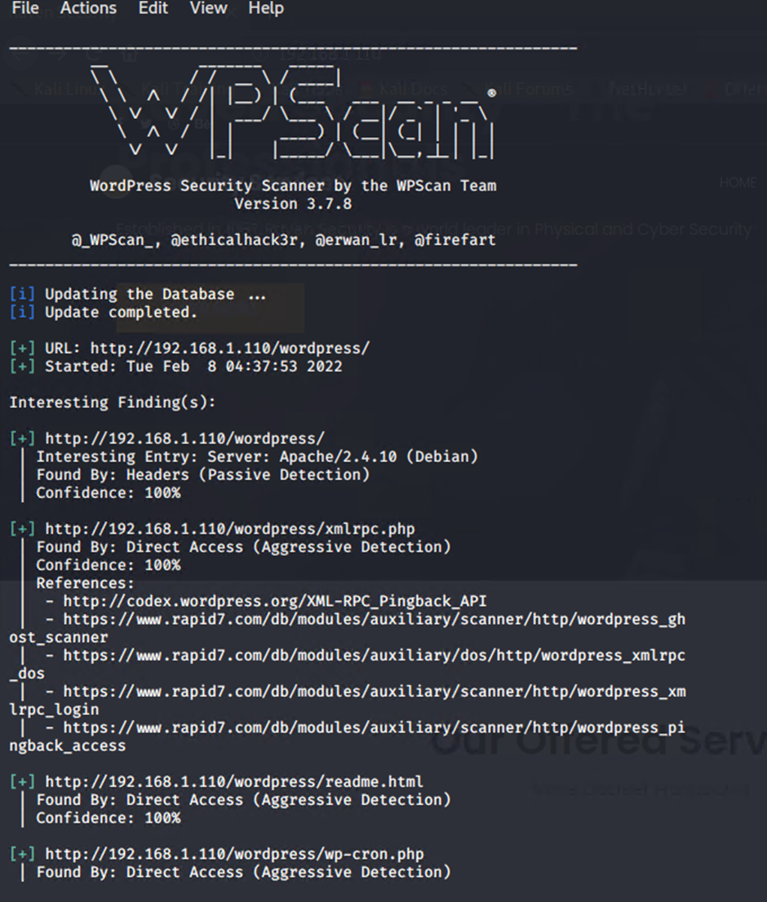
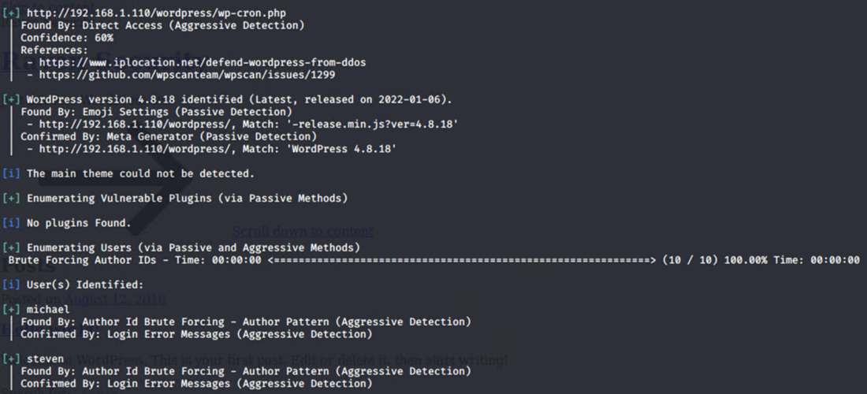

Exploitation: WordPress Scan
wpscan was performed to enumerate the users’ associated with the wordpress web site
# wpscan –url http://192.168.1.110/wordpress -eu
users found:
michael
steven

Slide 9
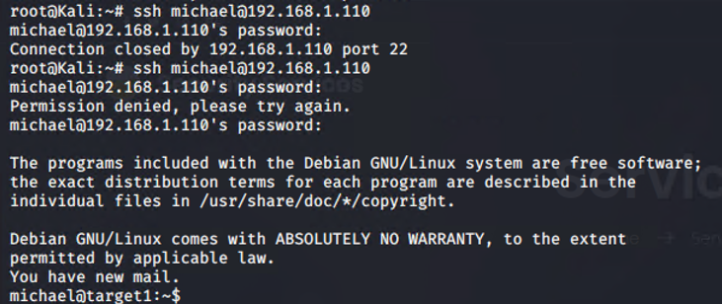
Exploitation: Weak Password
A SSH session was established with michaels username
Password was guessed after three attempts
ssh michael@192.168.1.110
Password michael

Slide 10
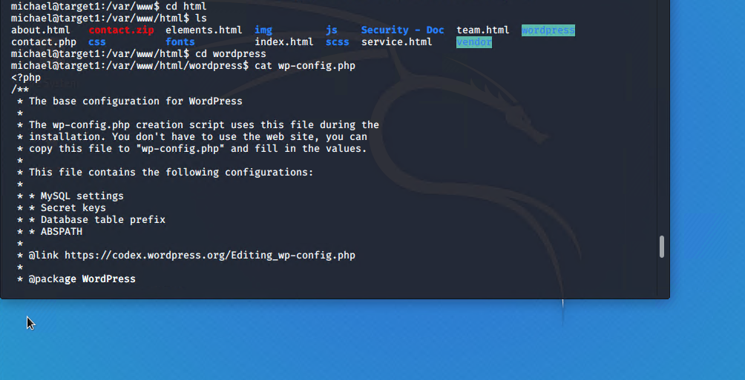
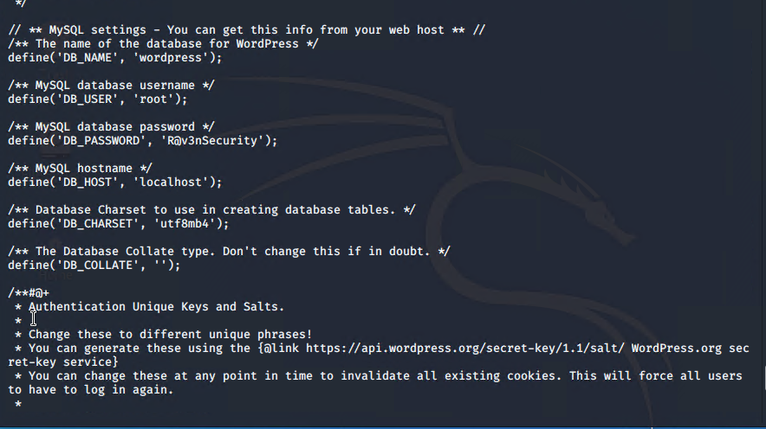
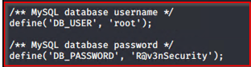
Exploitation: MySQL Database
Michael’s (user) privileges were utilised (as per previous exploit of weak passwords) to locate MySQL username and password for the Wordpress site database.
Access to MySQL database through root privilege escalation was successful.
/var/www/html/service.html
flag1{b9bbcb33e11b80be759c4e84486248d}
/var/www/flag2.txt
flag2{fc3fd58dcdad9ab23faca6e9a36e581c}

Slide 11
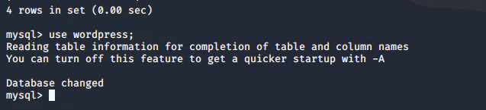
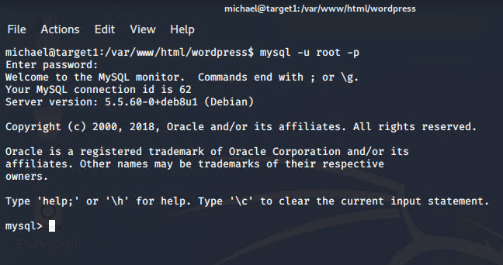
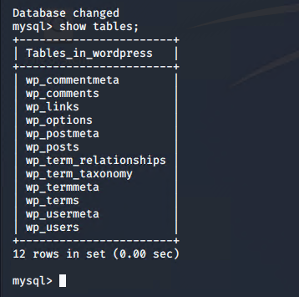
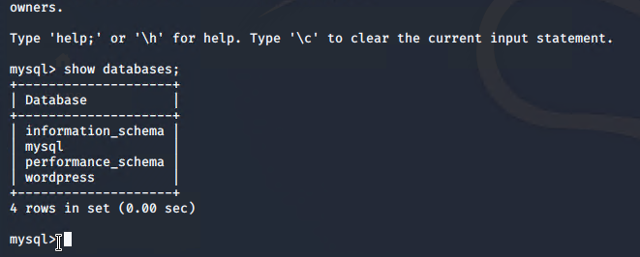
Exploitation: MySQL Database (cont.)
show databases;
use wordpress;
show tables;

Slide 12
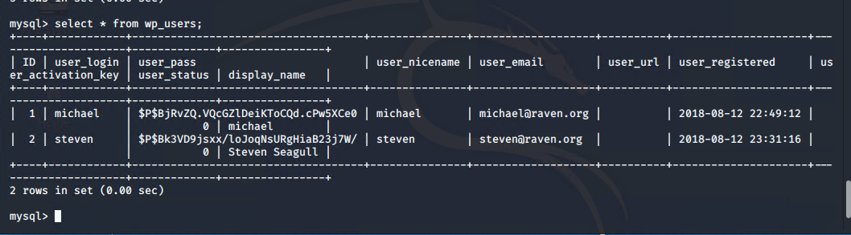
Exploitation: MySQL Database (cont.)
Discovered password hashes for the users steven and michael in the wp_users table
These discovered hashed were output to a file for further exploitation
select * from wp_users;
table wp_post
flag3{afc01ab56b50591e7dccf93312270cd2}

Slide 13
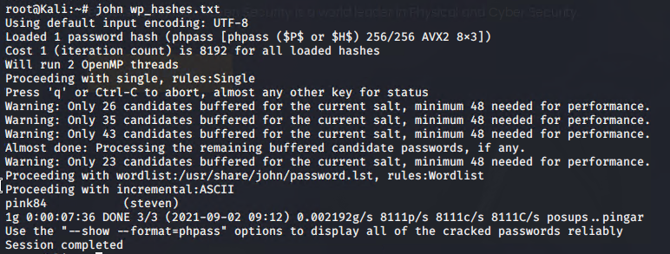
Exploitation: Unsalted User Password Hash
Password hashes from previous slide were output to wp_hashes.txt on Kali and John the Ripper was used to crack them
The second user password hash was able to be cracked (user steven)
username steven
password pink84

Slide 14
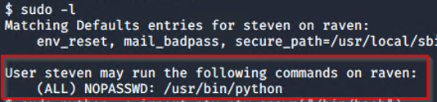
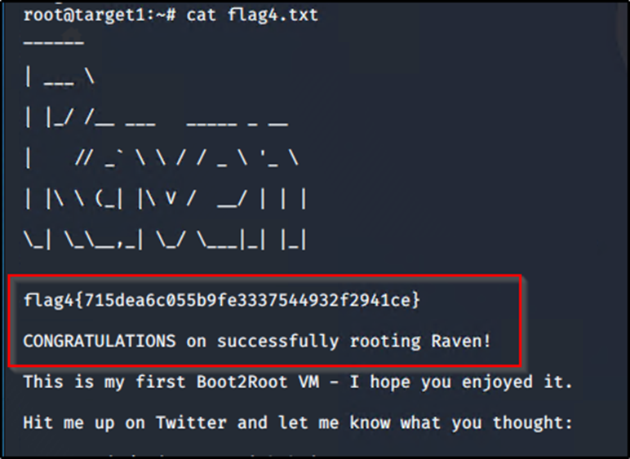
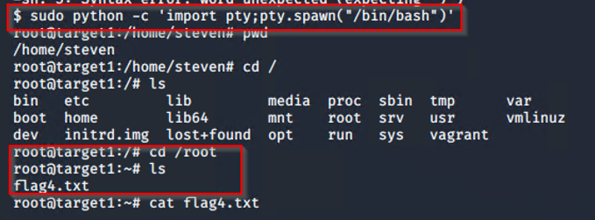
Exploitation: Python Pseudo Terminal /bin/bash exploit
Logged in as steven ssh steven@192.168.1.110
Discovered user has maximum sudoers privileges to execute Python with no password. Exploited a python pty vulnerability to gain root access and find flag 4.
list sudoers list as steven
$ sudo -l
/root/flag4.txt
flag4{715dea6c055b9fe3337544932f2941ce}
sudo python -c ‘import pty;pty.spawn(*”bin/bash”)’

Slide 15
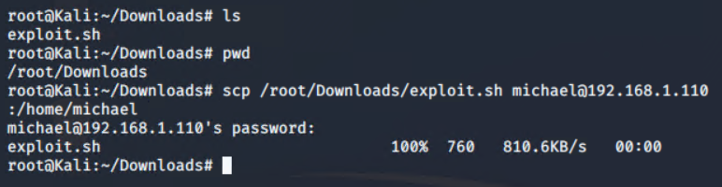
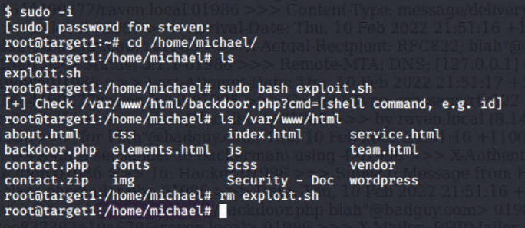
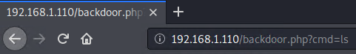
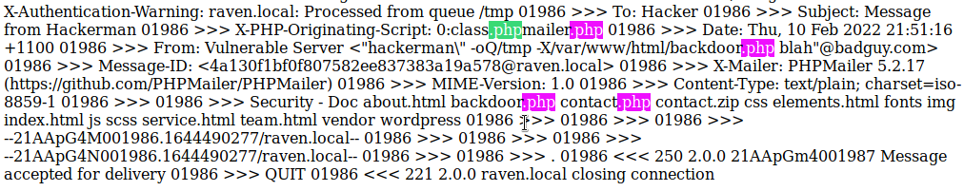
Exploitation: Advanced Persistent Threat
Used “scp” to upload malicious script to target via ssh port 22.
Established backdoor on “Target1”

Slide 16
Avoiding Detection
‹#›

Slide 17
Stealth Exploitation of Network Enumeration
Monitoring Overview
Which alerts detect this exploit?
WHEN sum() of http.request.bytes OVER all documents IS ABOVE 3500 FOR THE LAST 1 minute
Which metrics do they measure?
Packets requests from the same source IP to all destination ports
Which thresholds do they fire at?
The request bytes must exceed 3500 hits each minute
Mitigating Detection
To mitigate triggering the alert you can specify the number of ports you want to target and only known vulnerable ports would be scanned.
The number of HTTP requests could be staggered within the minute threshold.
nmap -p80, 22 -T1 192.168.1.110
Decoy or Zombie scan

Slide 18
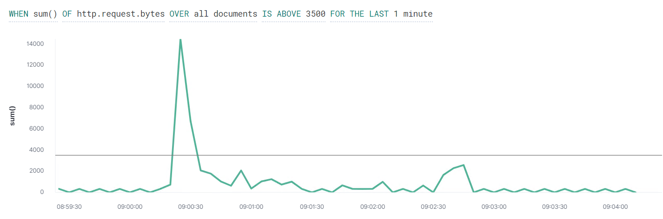
Kibana - Stealth Exploitation of Network Enumeration

Slide 19
Stealth Exploitation of WordPress Enumeration
Monitoring Overview
Which alerts detect this exploit?
WHEN count() GROUPED OVER top 5 ' http.response.status_code ' IS ABOVE 400 FOR THE LAST 5 minutes
Which metrics do they measure?
HTTP errors include unauthorized access requests (401) that may indicate an attack.
Which thresholds do they fire at?
When there are over 400 http response over a 5 minute period.
Mitigating Detection
To execute the exploit without triggering the alert a pause for 1 minute after every 100 http requests can are implemented.
An alternative option would be a stealthy wpscan option:
wpscan –url http://192.168.1.110/wordpress/ –enumerate u –stealthy

Slide 20
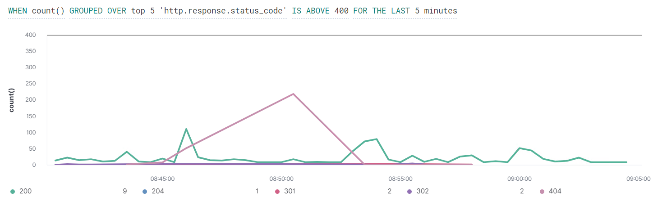
Kibana - Stealth Exploitation of Wordpress Enumeration

Slide 21
Stealth Exploitation of Password Cracking
Monitoring Overview
Which alerts detect this exploit?
WHEN max() OF system.process.cpu.total.pct OVER all documents IS ABOVE 0.5 FOR THE LAST 5 minutes
Which metrics do they measure?
System CPU Processes
Which thresholds do they fire at?
Above .5 per 5 minutes
Mitigating Detection
An alternative to using john on the target machine would be to move the wp_hashes.txt onto your own machine, this way your personal CPU is used. You want to avoid adding/changing files on the vulnerable machine to avoid detection.
Another option is to run john with OpenMP which brings Multi-Processing in and spreads the CPU load reducing the likelihood of reaching the threshold.
Notes:
CPU - central processing unit
Metric beat

Slide 22
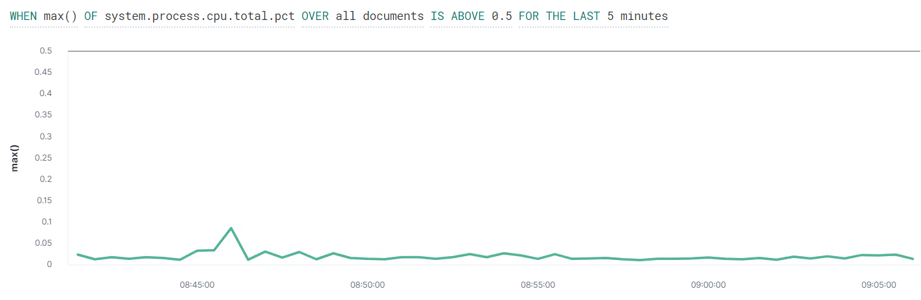
Kibana - Stealth Exploitation of Password Cracking

